Slide 1

Team Nourish
Identifying eating and drinking patterns from audio
Florian Rumpold
Lucas Pawlak
Maarten de Jonge

Slide 2
Research paper
Created the skeleton of the paper
Introduction, the conclusion.
Need to fill the chapters now.

Slide 3
Reducing the training time
First Training of simple Model took 4 hrs.
Solution: Save Melspectrogram tensors to disk and load them dynamically
Reduced to 6 mins for 100 Epochs

Slide 4
Creating Models
Tried linear Models with and without Convolutional Layers
Experimented with Layer sizes
Oscillating accuracy score for validation set
Overfitting right from the start

Slide 5
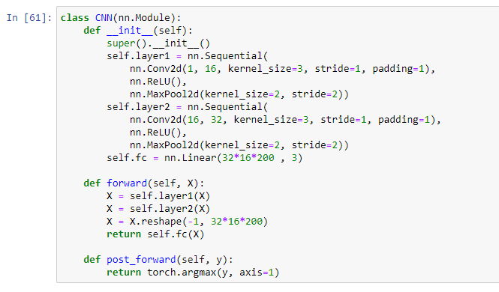
Best model so far

Slide 6
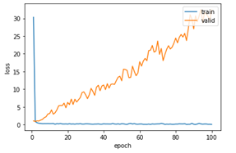
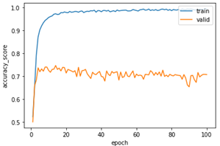
Loss & Accuracy

Slide 7
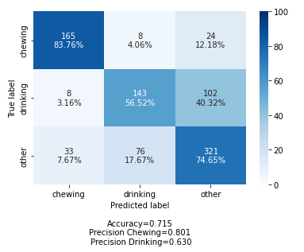
Validation set

Slide 8
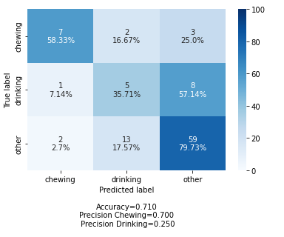
Test set

Slide 9
Next steps
Adding Dropout to counter overfitting
Implementing our own Trainer class, to better display important metrics
Continue working on the Research paper
Learning lab

Slide 10
Questions, Feedback & Advice are very welcome!

